Slide 1



MongoDB Administration

Slide 2

Objectives
Explain storage engine and capacity planning
Discuss administration in MongoDB
Explain database health check/monitoring
Outline backup strategies
Discuss tools in MongoDB package

Slide 3

Storage Engines

Slide 4

Storage Engines
A Storage engine defines data storage protocol.
It manages data on a disk and in memory.
MongoDB supports various storage protocols.
All storage engines support specific workloads.

Slide 5
Types OF Work Loads
01
02
03
Heavy read operations
Heavy write operations
Mix of read and write operations

Slide 6
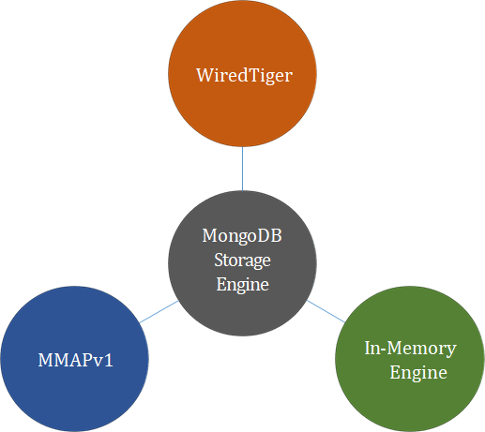
Types Of Storage Engines

Slide 7

Mmapv1 Storage Engine
MMAPv1 is the original MongoDB storage engine for version 3.0 and earlier.
To ensure that all modifications to a MongoDB data set are durably written to disk.
MongoDB, by default, records all modifications to an on-disk journal.
MongoDB writes to the data files on disk every 60 seconds.
It writes to the journal files roughly every 100 milliseconds.
It stores and accesses data via memory-mapped files.
MongoDB automatically uses all free memory on the machine as its cache.

Slide 8

Memory-mapped Files
A memory-mapped file contains data stored by the operating system in its memory.
Memory-mapped files use the mmap() system call to store data.
Memory-mapped files enable MongoDB to:
Access and manipulate data fast.
Manage and interact with all types of data.
Assign data files to a virtual memory block having a byte-for-byte correlation.

Slide 9

WiredTiger Storage Engine
WiredTiger storage engine is available in 64-bit builds, starting from MongoDB 3.0.
It uses document-level concurrency control for write operations.
WiredTiger provides a point-in-time snapshot of the data to the transaction MongoDB configures.
WiredTiger to create checkpoints.
WiredTiger storage engine is the default storage engine starting from MongoDB 3.2.

Slide 10
WiredTiger Vs. Mmapv1
 | WiredTiger | MMAPv1
Write Performance | Excellent Document-Level Concurrency Control | Good Collection-Level Concurrency Control
Read Performance | Excellent | Excellent
Compression Support | Yes | No
MongoDB QLS | Yes | Yes
Secondary Index | Yes | Yes

Slide 11







Power Of 2-sized Allocations
MongoDB version 3.0 uses the power of 2-sized allocation as the default record allocation strategy for the MMAPv1 storage engine.
The power of 2-sized allocation strategy has the following key properties:
Can reuse freed records and reduce fragmentation.
Can reduce moves.

Slide 12
Database Monitoring

Slide 13


Database Health Check
Database health check can avoid any issue/problem.
You can get optimal performance.
It helps minimize downtime.

Slide 14
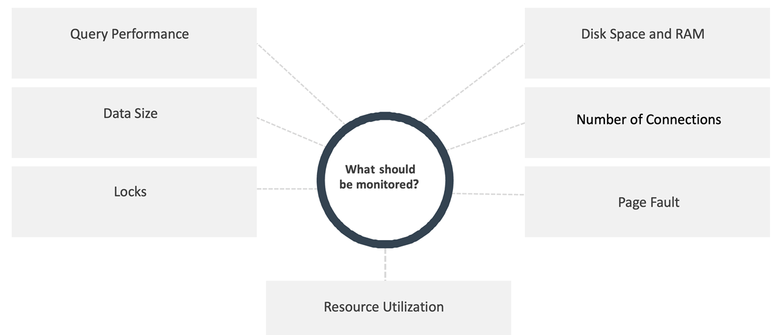
Database Monitoring (Contd.)

Slide 15
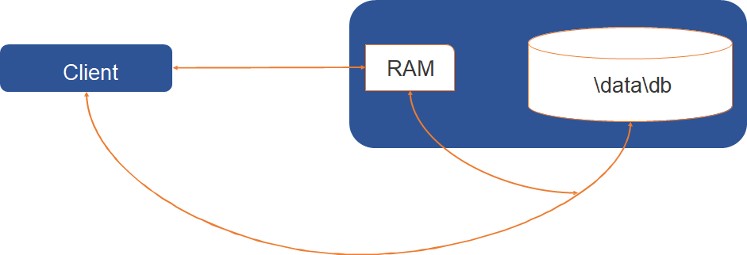
PAGE FAULT

Slide 16
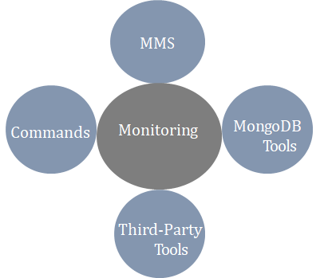
MONITORING STRATEGIES FOR MONGODB
Monitoring is a critical component of database administration.
Strategies used for collecting data and monitoring a MongoDB instance are as follows:

Slide 17
Monitor Through Command Line
@Server Level | db.serverStatus()
@Database Level | db.stats()
@Collection Level | db.collectionname.stats()
Current Operations | db.currentOp()
Replication Status | db.replSetGetStatus()

Slide 18
Optimization Strategies For MongoDB
Many factors can affect the database performance and responsiveness.
The following techniques are used for evaluating the operational performance of MongoDB:
Database Profiler
Capped Collections
$Natural Order

Slide 19

Thank you!

